Slide 1



BankBot AI – Chatbot for Banking FAQs
TEAM THREE MEMBERS:
Kokilavani M
SV Maheswari devi Peddireddy
Mohini Anand Mane
Shubham Raj

Slide 2



Project Overview:
Problem Background
Banks receive a large number of repetitive customer queries daily
Manual handling leads to delayed responses and higher workload
Customers expect quick and anytime support
Proposed Solution
BankBot AI is an AI-based chatbot developed to answer common banking questions
Uses NLP techniques to understand user queries
Provides instant and accurate responses without human intervention
Advantages
Available at all times
Reduces manual customer service effort
Faster query handling
Enhances customer experience

Slide 3
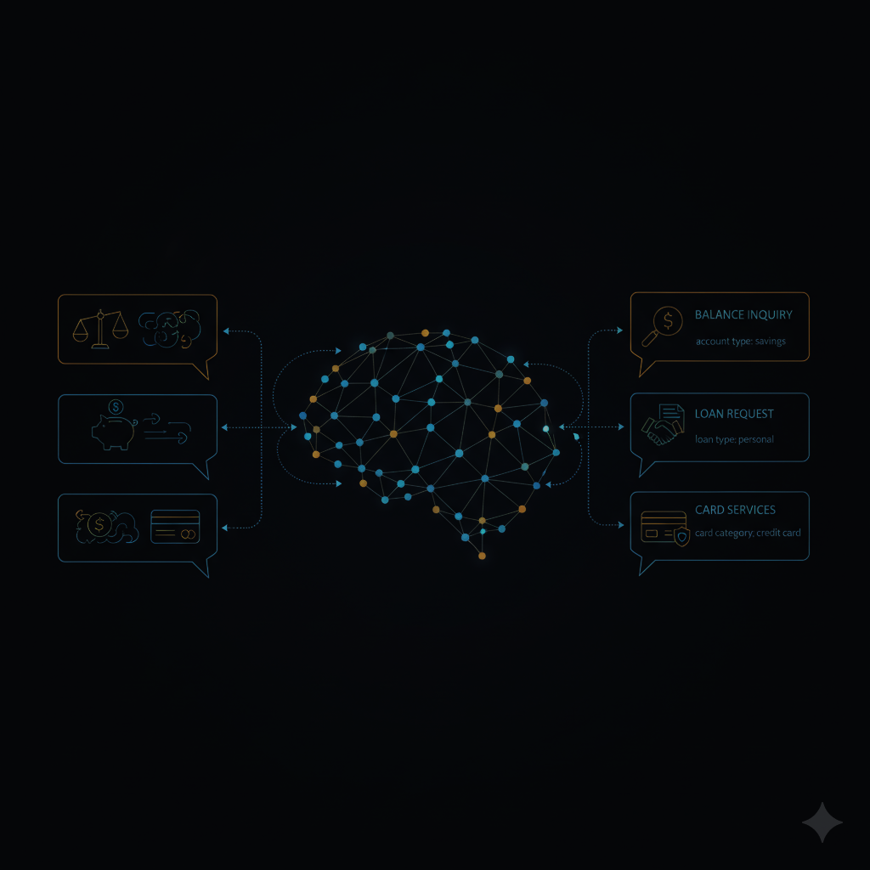
MILESTONE 1: INTENT & ENTITY RECOGNITION
Understanding User Queries
Identified important banking-related intents such as:
Balance enquiry
Loan-related queries
Debit and credit card services
General banking FAQs
Trained an NLP model using spaCy for intent detection
Implemented entity extraction to identify details like:
Account type
Loan type
Card category

Slide 4
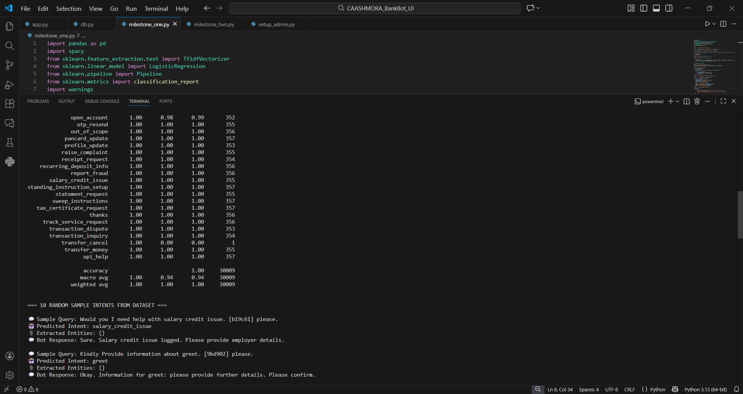
Result: The chatbot accurately understands user intent and extracts required information.

Slide 5

MILESTONE 2: DIALOGUE MANAGEMENT
Managing Conversations Effectively
Designed logical conversation flows using rule-based logic
Enabled context handling for follow-up questions
Added fallback responses for invalid or unknown inputs

Slide 6
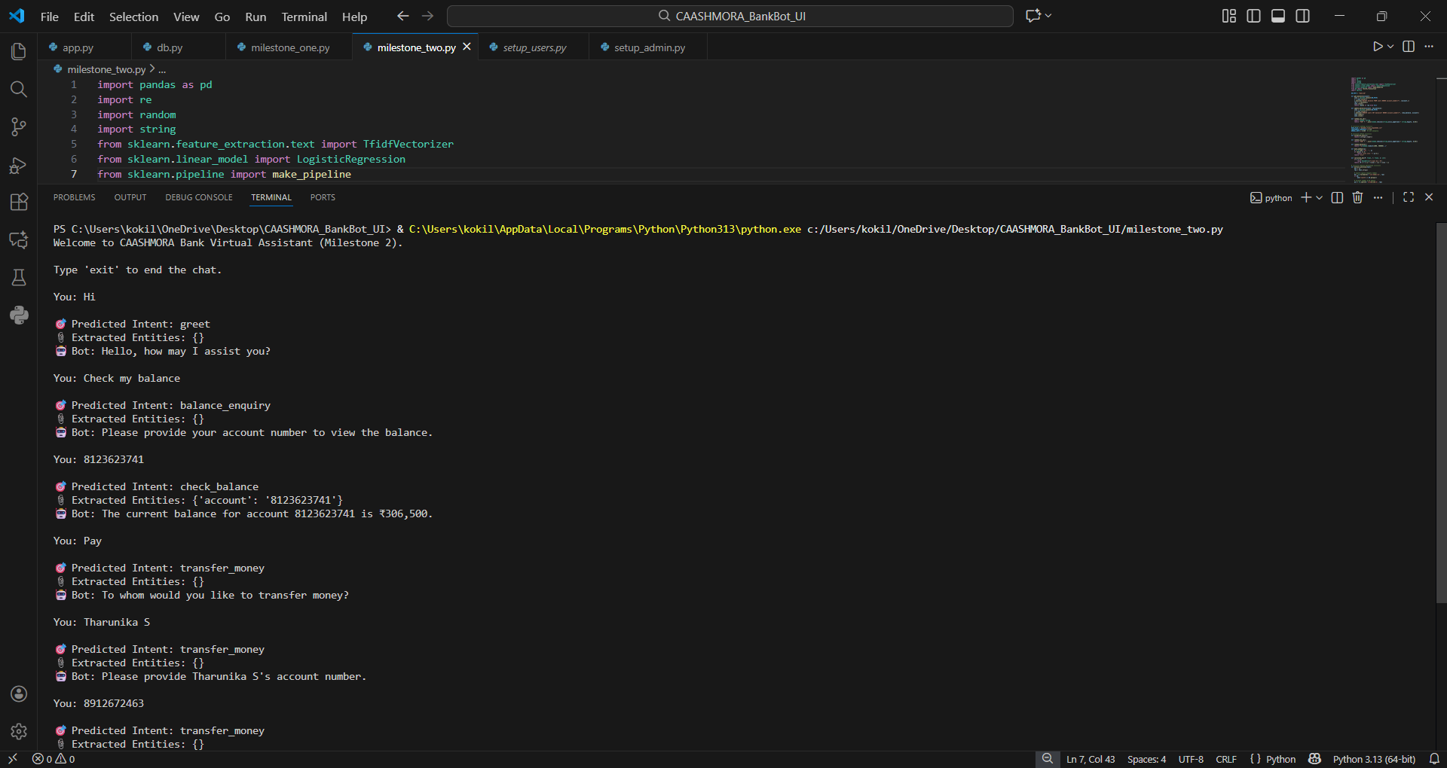
Result: The chatbot maintains smooth and meaningful conversations with users.

Slide 7

MILESTONE 3: USER INTERFACE DEVELOPMENT
User Interface & Integration
Frontend Development
Developed chatbot interface using HTML, CSS, and JavaScript
Backend Connectivity
Connected frontend with Flask backend using APIs
Enabled real-time communication between user and chatbot
UI Enhancements
Simple and clean interface
Proper validation and error handling

Slide 8
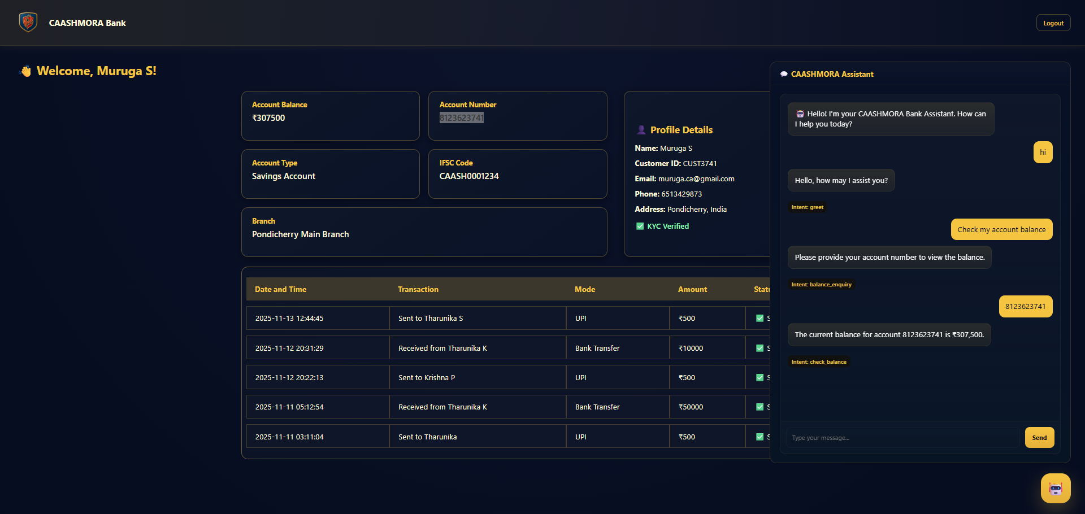
Result: A fully functional and responsive chatbot UI was successfully integrated with the backend, enabling smooth real-time user interaction.

Slide 9

MILESTONE 4: ADMIN & KNOWLEDGE MANAGEMENT
Administration and Maintenance
Created an admin panel to manage:
Banking FAQs
Training data
User interaction logs
Added analytics support for monitoring chatbot usage
Provided retraining option to improve chatbot accuracy

Slide 10
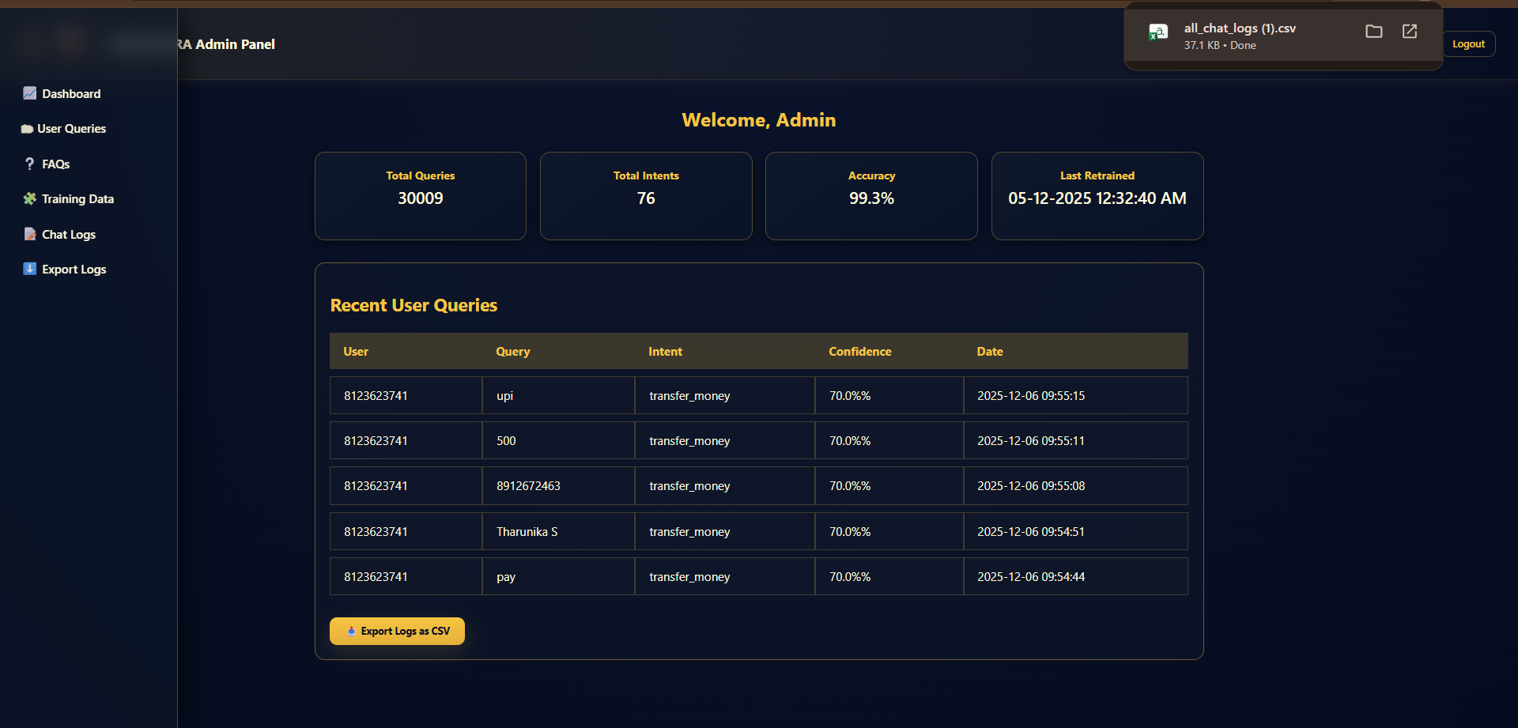
Result: A fully functional admin panel was implemented to manage data, monitor chatbot performance, and support model retraining.

Slide 11

TECHNOLOGY USED
Tools & Technologies
Python – Core programming language
Flask – Backend framework
SpaCy – NLP processing
HTML, CSS, JavaScript – Frontend interface
SQLite – Data storage
Local / Cloud Deployment

Slide 12

PROJECT OUTCOMES
Results Achieved
Successfully automated frequently asked banking queries
Reduced dependency on manual customer support
Delivered fast and reliable chatbot responses
Built a system that can be improved with new data

Slide 13

FUTURE ENHANCEMENTS
Real-Time Banking API Integration Connect the chatbot with live banking systems to provide real-time balance, transaction, and account details.
Voice-Based Interaction Enable voice input and output to improve accessibility and user convenience.
Multilingual Support Extend the chatbot to support multiple languages for better user reach.
Advanced Analytics Dashboard Enhance the admin panel with detailed analytics on user behavior, intent trends, and performance metrics.
Improved Model Accuracy Continuously retrain the NLP model using larger and more diverse datasets to improve response quality.

Slide 14

Thank You
I would like to sincerely thank
My mentor Suriya varshan V
for their valuable guidance and support throughout this project.
This project was completed under the
Infosys Springboard Internship Program.

